Slide 1
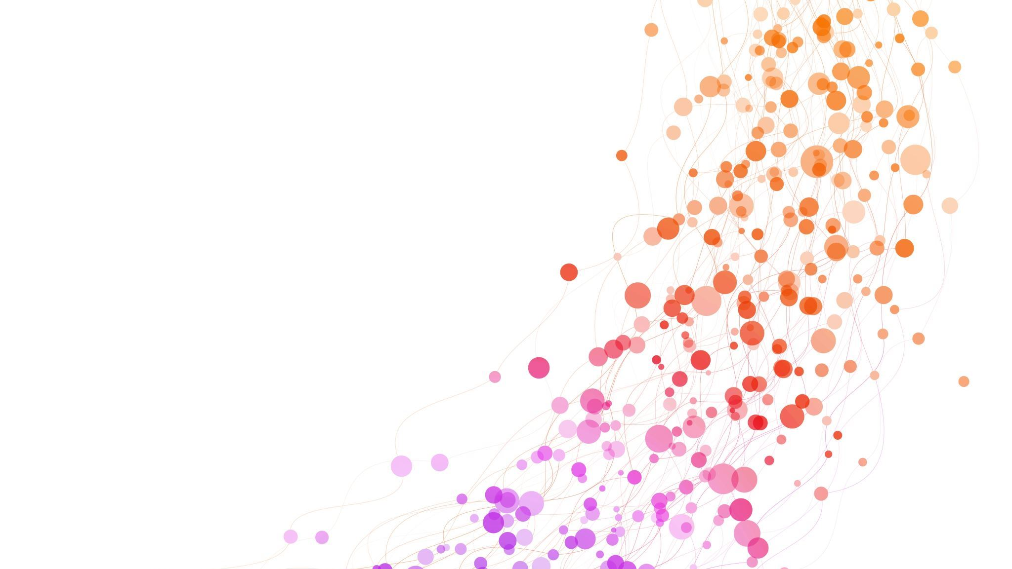
U&I UI wireframe cards
Group 1
J.H. Bussemaker
M.A. Dijkman
A.L. van Esch
E.T.C. Janus
S.R. Liebe
T. Tuitert

Slide 2
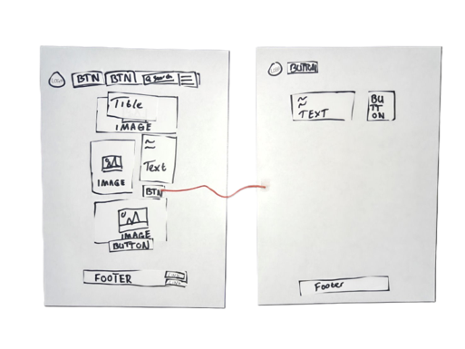
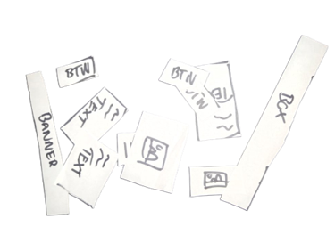
The concept
Scope
Idea
Problem space
Audience

Slide 3

Goals & Hurdles
Goal formulation
Technical hurdle

Slide 4
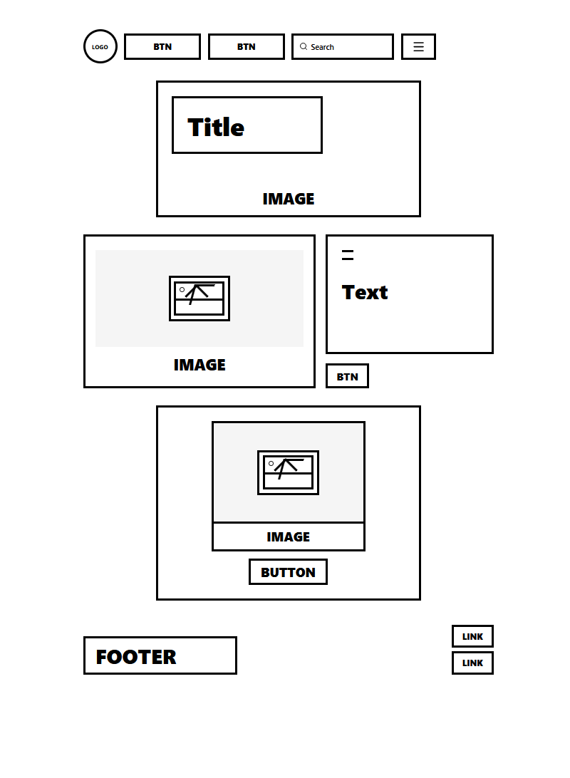
The materials
Seed
Toolbox
Prompt
Tools
Notes:
Prompt: use the U&I kit to prototype UI website designs in a group.
Seed: cards with individual site elements on them. For example, card with an image of a product on it, or blank cards which people can write on.
Toolbox: Plasticised papers with magnets to write on, Unity application that can scan the papers and translate them to website code.
Tools: A phone for scanning

Slide 5
Scaffolding & Facilitation
On-boarding
Support
Notes:
Introduction presentation given to introduce people to the concept
Simple guide for the application, likely part of presentation
1 facilitator who instructs and walks around to make sure people aren't getting stuck.

Slide 6
Process & Instruction
Timing
Location
Introduction
Monitoring
Notes:
5-minute introduction – 20-minute website creation – 15-minute show & tell
One table per group, each group a box of cards, more cards in the centre if need be, one big screen per group to show the website design to the whole group
Instruction: Welcome to our website design session! The goal is to use all the tools around you to build a website design which fits your wishes. We will show how you can use the different tools and then it’s up to you to unleash your creativity and come up with the creasiest website designs. (NOW EXPLAIN THE DIFFERENT TOOLS)
Monitoring: Supervisor looks for people struggling with the technology. Commonly, don't hide the ArUco codes

Slide 7
Thank you!

Slide 8
Title | U&I: UI Wireframing cards
Scope (short description) | A physical, collaborative tinkering toolkit that enables non-technical stakeholders to design and discuss a low-fidelity website by building it with magnetic UI cards and optionally scanning it into a digital wireframe.
Idea | Translate wireframing into a physical experience so early website design becomes more accessible, discussable, and collaborative.
Problem Space | Designing a website digitally takes time and can be hard to do collaboratively. Current wireframing software has a learning curve and often shifts attention to software skills instead of structure, content, and user flow. This makes it harder for non-technical stakeholders to participate meaningfully.
Goal formulation (intended outcome) | Allow everyone to build their desired website design without the need for coding. Explore different layouts for your website design. Makes the outcome more concrete and more ‘sharable’
Technical hurdles to solve | Facilitating UI web design for people without coding experience Reliable recognition of the cards and their positions
Audience | Stakeholders in creating a website that would like to do it without coding or another technical knowledge.
Materials
Seed | Different magnetic cards that represent different parts of websites/UI that can be scanned in and moved around to form the design
Toolbox | The physical building blocks are plasticized paper pieces on which the user can write. These pieces are magnetic and can be placed on a whiteboard. The virtual buildings blocks will be a Unity application or AI integration. Basically, a wireframe scanning application (recognizes where parts are).
Tools
 | Phone
Scaffolding/Facilitation
What do you need? Which onboarding? | A simple introduction presentation that is given or can be viewed without further instructions and a simple guide for the application (that can also be implemented in the presentation)
Support | 1 facilitator who instructs and walks around
Planning / Process
Timing | 5-minute introduction – 20-minute website creation – 15-minute show & tell
Location / setup | One table per group, one table with available cards, one big screen per group to show the website design to the whole group
Instruction
Introduction | Welcome to our website design session! The goal is to use all the tools around you to build a website design which fits your wishes. We will show how you can use the different tools and then it’s up to you to unleash your creativity and come up with the creasiest website designs. (NOW EXPLAIN THE DIFFERENT TOOLS)
Monitoring | As supervisor: Look for people struggling with the technology In general: don't hide the ArUco codes

